Slide 1
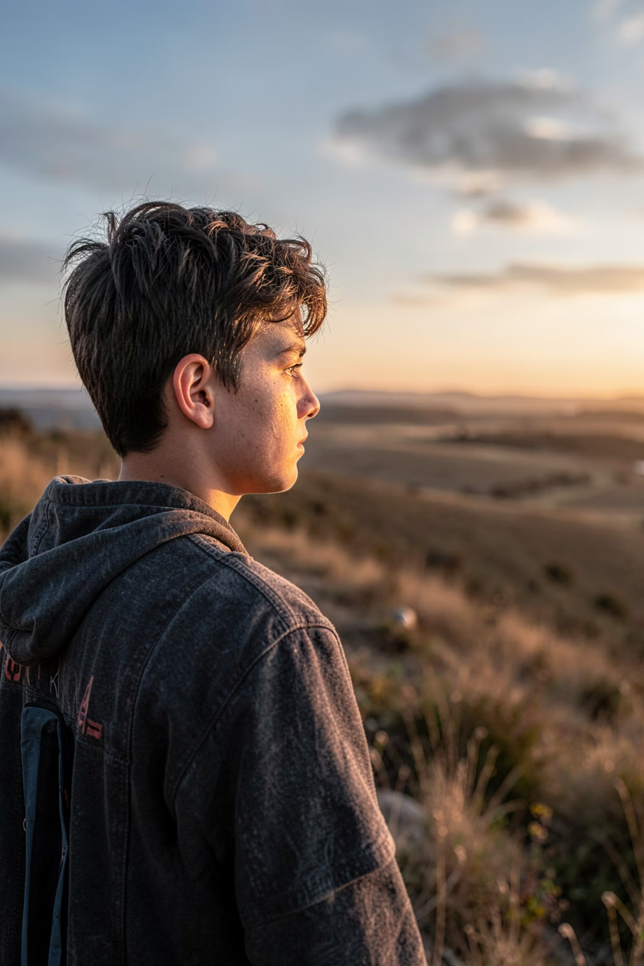

If Clauses
ENGLISH GRAMMAR
YEAR 9
Mastering Conditionals:
From Facts to Dreams
Conditionals are the secret to talking about what happens, what could happen, and what we dream of. We use them all the time — in science, in daily life, and in our wildest imaginations.
By the end of this lesson, you will confidently use Zero, First, and Second Conditionals, plus a powerful word called unless.
Notes:
We can also name it as if clauses

Slide 2
THE ZERO CONDITIONAL
Laws of the Universe
We use the Zero Conditional to talk about facts, scientific truths, and personal habits. The result is 100% real — it always happens.
Structure: If + Present Simple, Present Simple
Facts & Science
Habits & Routines
If you heat ice, it melts.
If you mix red and blue, you get purple.
If it rains, the grass gets wet.
If I am tired, I go to bed early.

Slide 3

THE FIRST CONDITIONAL
Future Possibilities
Use the First Conditional to talk about likely future outcomes. The condition is realistic — it could genuinely happen.
Structure: If + Present Simple, Will + Verb
Plans & Consequences
Real-World Scenarios
If you study hard, you will pass the exam.
If it rains later, we will stay home.
If he invites me, I will go to the party.
If you don't hurry, you will miss the bus.

Slide 4
PRACTICE TIME
First Conditional Exercises
Can you master Zero & First Conditionals? Fill in the blanks with the correct tense!
1. 🌡️ If you ____________ (heat) water to 100°C, it ____________ (boil).
2. 🌱 If plants ____________ (not get) sunlight, they ____________ (die).
3. 😴 If people ____________ (not sleep) enough, they ____________ (feel) tired.
4. 📚 If she ____________ (study) every day, she ____________ (pass) the exam.
5. 🌧️ If it ____________ (rain) tomorrow, we ____________ (cancel) the picnic.
6. ✈️ If they ____________ (save) enough money, they ____________ (travel) to Japan.

Slide 5

THE SECOND CONDITIONAL
Hypothetical Worlds
Use the Second Conditional for imaginary or unlikely situations. We dream, we wonder, we explore "what if?"
Structure: If + Past Simple, Would + Verb
Dreams & Wishes
Advice & Imagination
If I had a lot of money, I would buy a boat.
If we won the lottery, we would travel the world.
If I were you, I would study more.
If he lived in London, he would speak English every day.
Tip: In the Second Conditional, we often use were instead of was for all subjects — "If I were you..."

Slide 6





PRACTICE TIME
Second Conditional Exercises
Time to dream! Put the verbs into the correct tense for imaginary situations.
1. If I ____________ (be) a bird, I ____________ (fly) over the ocean.
2. If he ____________ (have) more time, he ____________ (learn) the guitar.
3. If we ____________ (live) in space, we ____________ (see) stars every day.
4. If she ____________ (know) the answer, she ____________ (tell) us.
5. If they ____________ (come) to the party, they ____________ (have) a great time.

Slide 7
CHALLENGE
MIXED
Mixed Conditionals Challenge
Which conditional fits? Choose between Zero, First, and Second to complete each sentence correctly.
If
+
Result
Type
Your Answer
1
it (be) sunny
→
I __ to the park
?
_____
2
she (study)
→
she will pass
?
_____
3
I (be) rich
→
I would travel
?
_____
4
water (reach) 100°C
→
it boils
?
_____
5
you (not listen)
→
you won't understand
?
_____

Slide 8
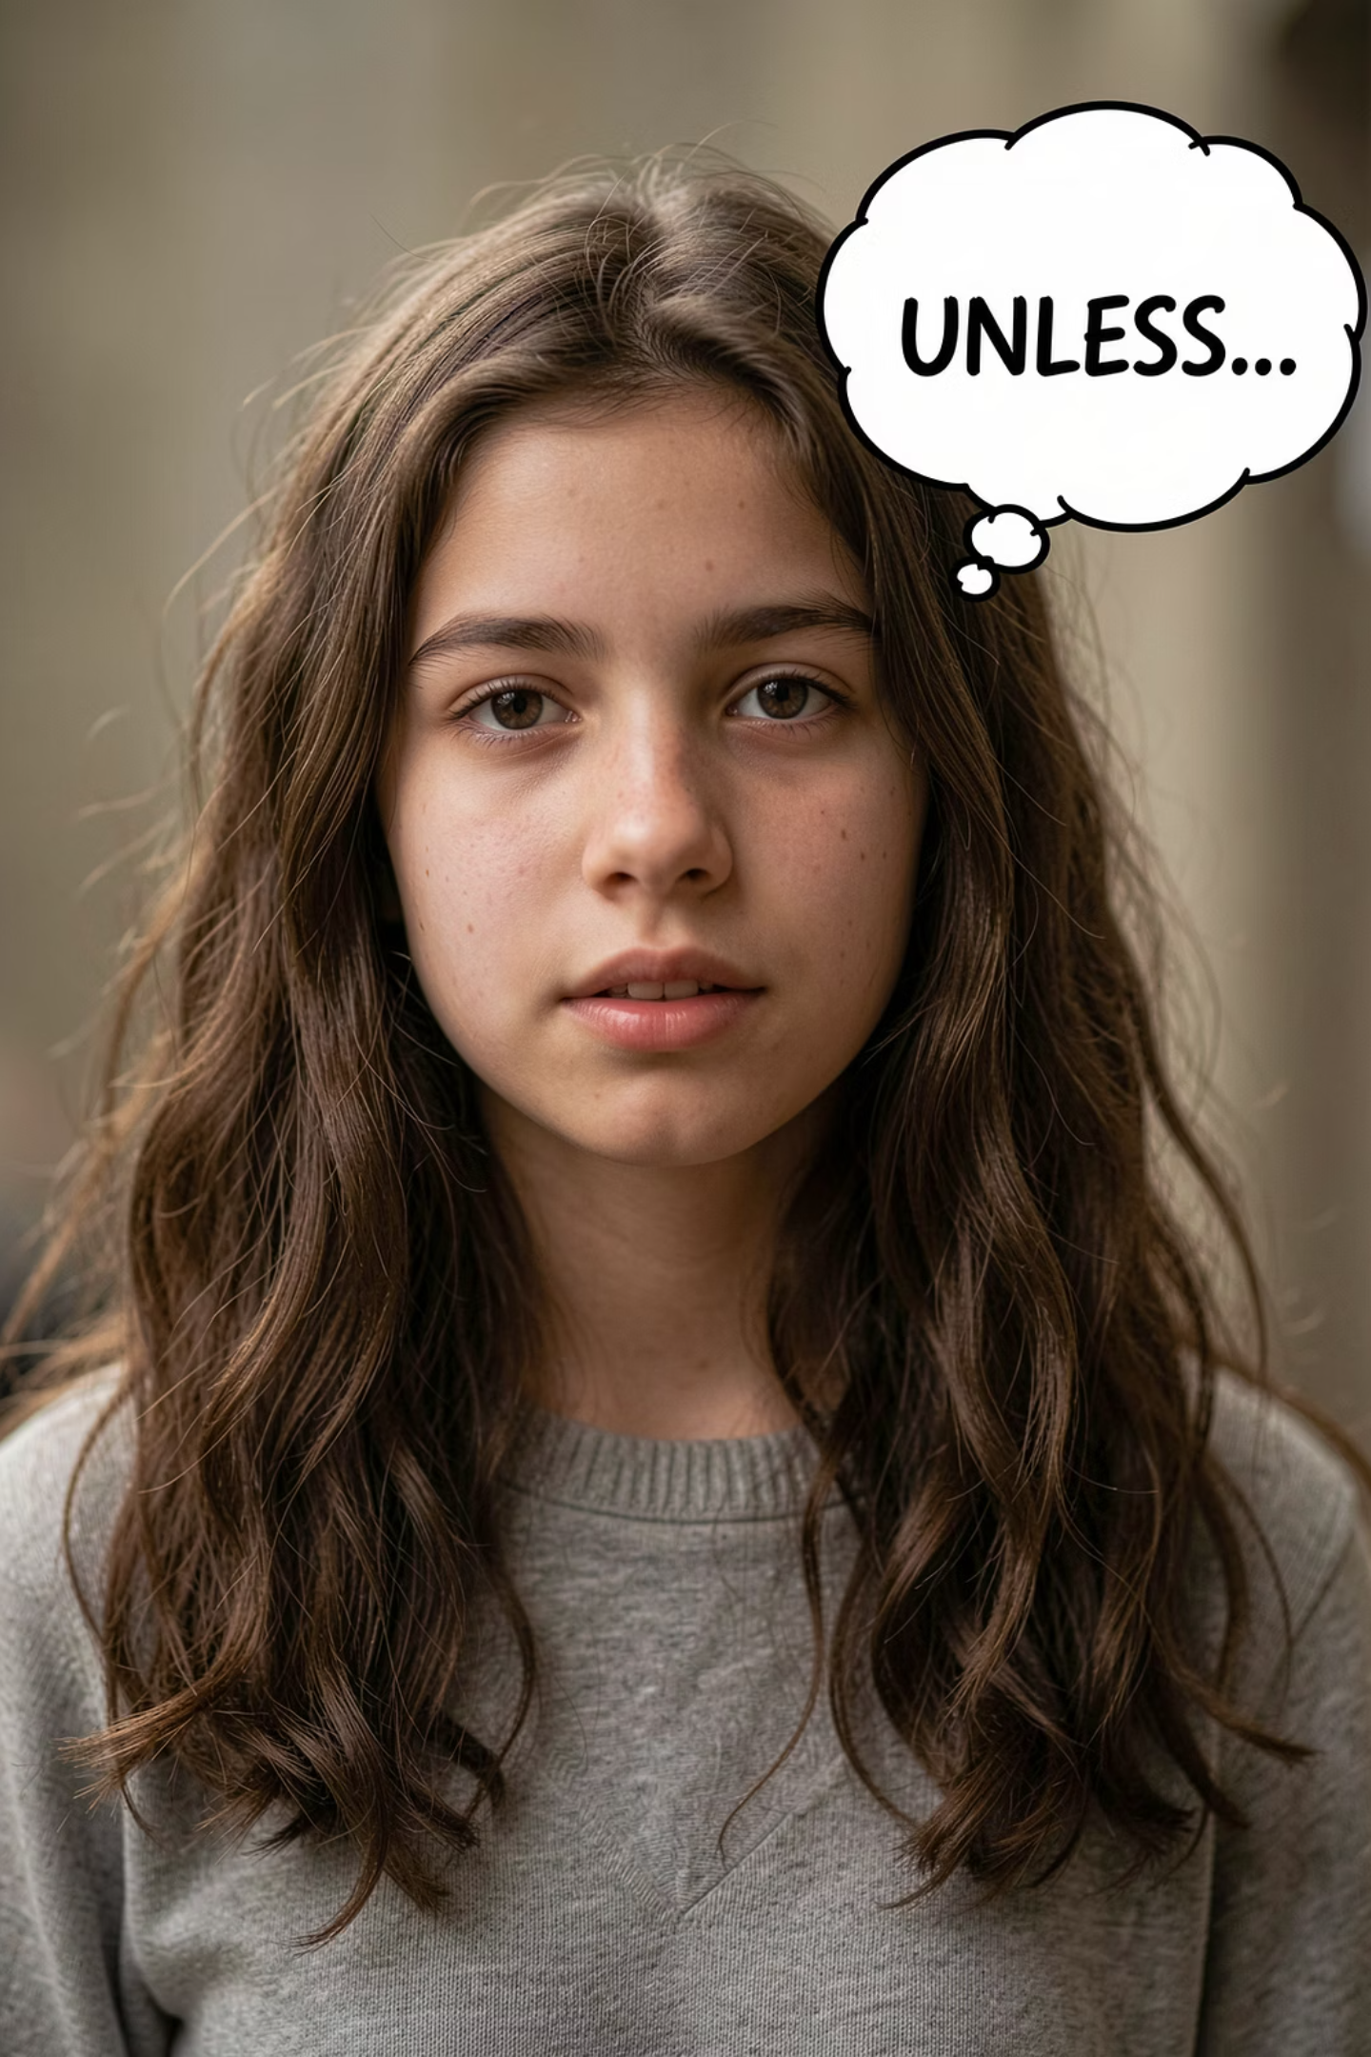

NEW SKILL
The Unless Rule
Unless means exactly the same as if not. We use it to say that something will happen only if something else doesn't happen. It makes your sentences sound stronger and more direct.
1
2
Consequence
Plans
Unless you study, you won't pass.
Unless it rains, we will play outside.
3
4
Condition
Urgency
I won't go unless you come with me.
You will be late unless you leave now.

Slide 9





YOUR TURN
Unless Practice
Rewrite each sentence using unless. Remember: unless replaces if not.
1. If you don't hurry, you will miss the train.
→ ______________ you hurry, you will miss the train.
2. If she doesn't practice, she won't improve.
→ ______________ she practices, she won't improve.
3. If you don't eat, you will be hungry.
→ ______________ you eat, you will be hungry.
4. If he doesn't call, I will be worried.
→ ______________ he calls, I will be worried.
Bonus: Can you write your own sentence using unless?

Slide 10
CONCLUSION
Use Your Words to Change Your World
Conditionals are powerful tools. They let you describe reality, plan for tomorrow, and dream without limits. Keep practising to unlock your full fluency!
Zero
First
Second
Use to describe reality and facts that are always true.
Use to plan for the future and likely outcomes.
Use to imagine new possibilities and hypotheticals.
🔥 Unless you practise, you won't improve — so go out there and SHINE! 🚀✨

